Slide 1
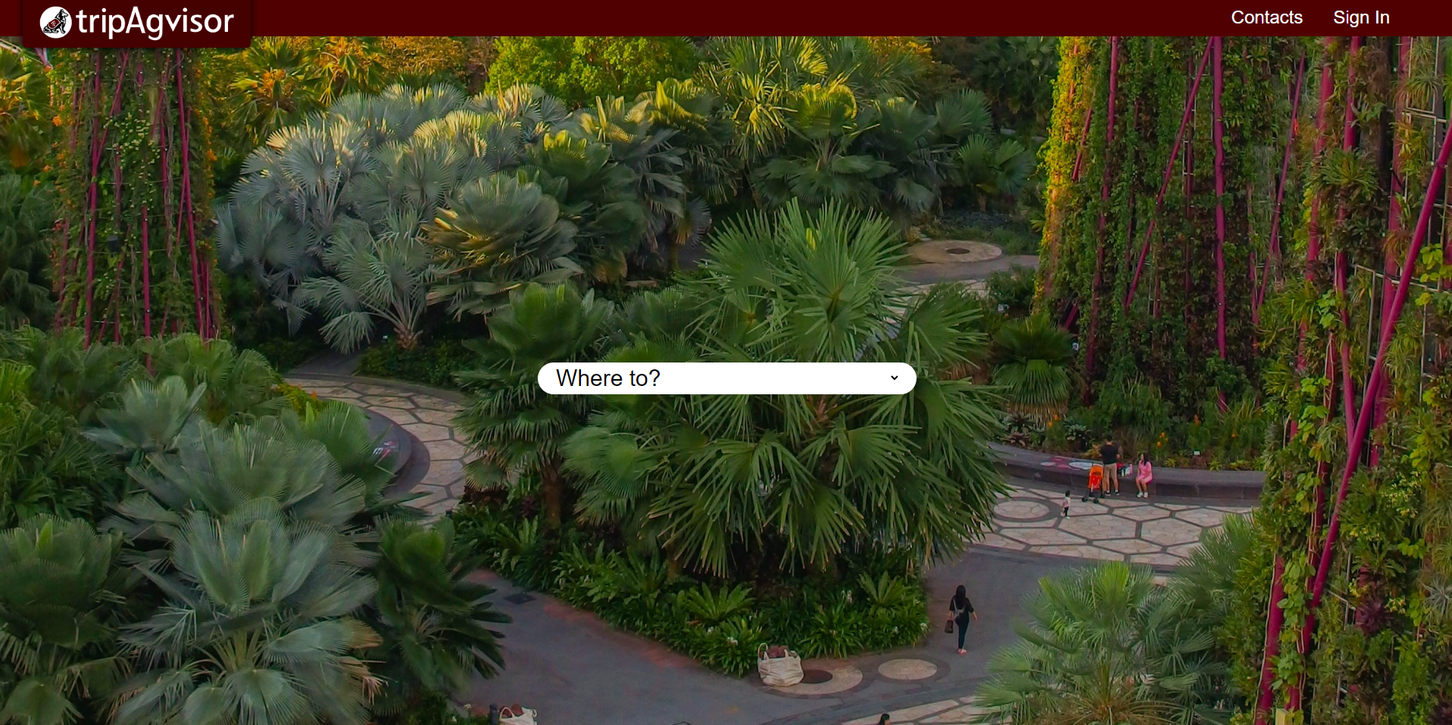
Study Abroad Experience Reviews
Blain Judkins
Kylee Friederichs
Parul Damahe
Tejasri Swaroop Boppana
Yijin Fang
Yu-Hsi Lin
Notes:
In your poster/slide presentation and live demo, you should describe the application and walk through the major use cases. You may also explain some of the design choices you made while working on your project. The poster/slide(s) should introduce your application, your design, and challenges and lessons you have learned about the software engineering process.

Slide 2
Main Objective
What ?
This is a review website for Aggies to share their experiences and useful tips from a study abroad trip.
Why ?
The website would contain helpful information for the students going for study abroad trips.
Who ?
The website can be used by current and prospective study abroad students.

Slide 3
Main Design
As an user of this website, here are some of the basic things that you can do:
Add an experience and rate it.
Add a tip.
Mark a tip as helpful.
Comment/Rate an experience.
Bookmark an experience to save for later.
Upload photos/View all photos in a gallery.
Add a location to an experience.

Slide 4
Functionalities
Bookmark an experience to refer to it in the future
Upload multiple images as a part of an experience.
View the images in a carousel.
Viewing the full image in a popup window.
Add a location for the experience and redirect to google maps on click.
Search/filter experiences by location.
Automatic email notification to a banned user with reason.
Random background images on reload.
View all the images for a program in a gallery.
Redirect to the experience when clicking on an image in the gallery.

Slide 5
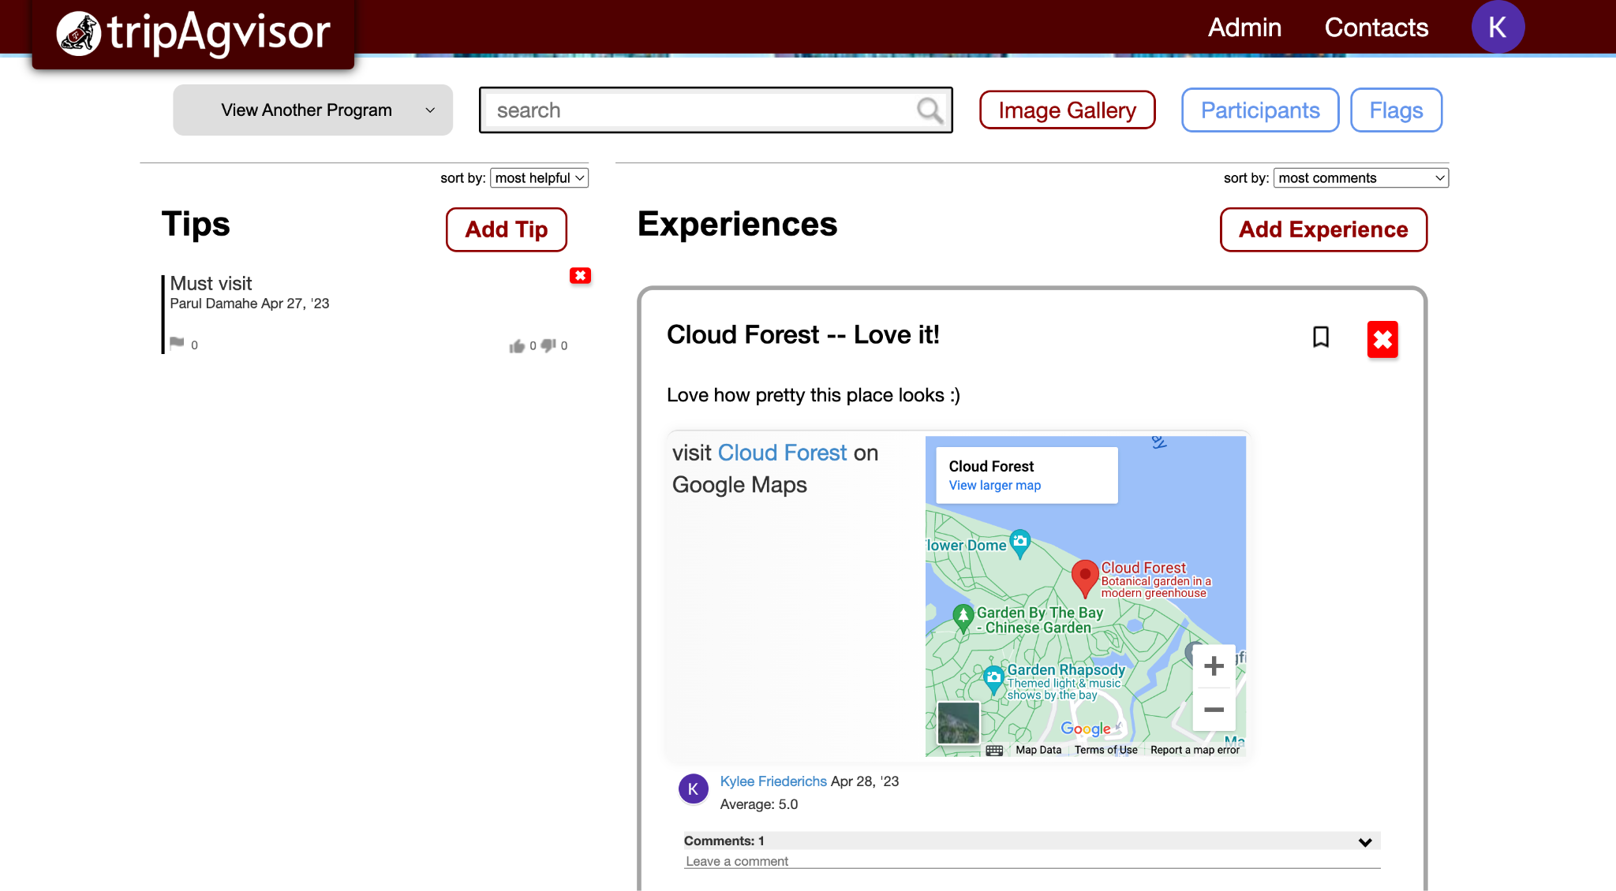

Slide 6
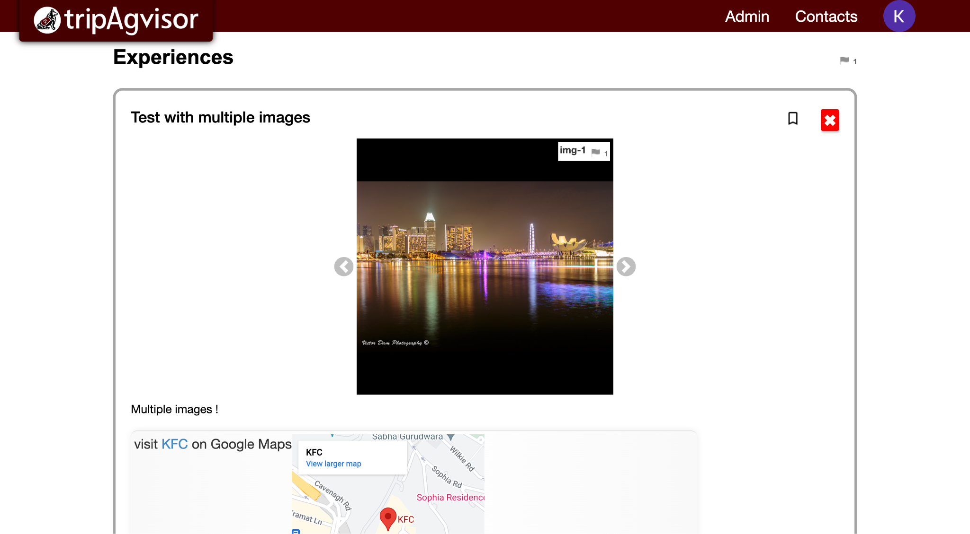

Slide 7
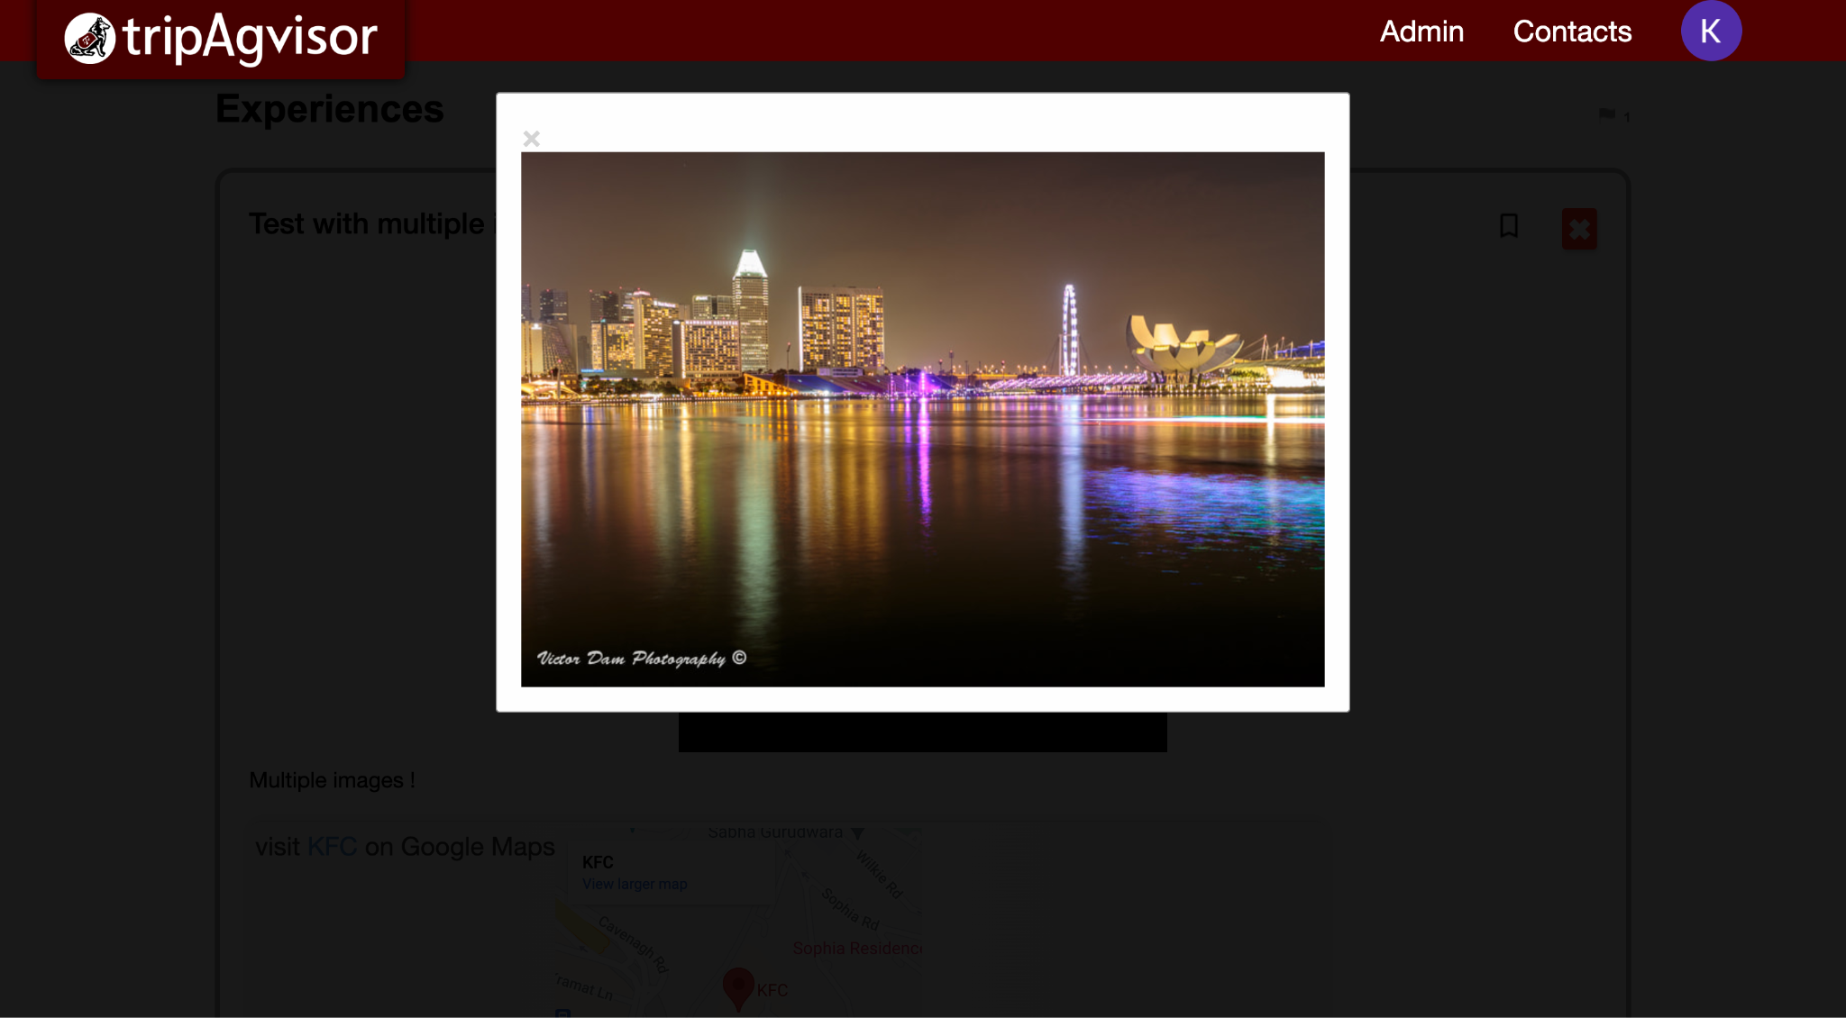

Slide 8
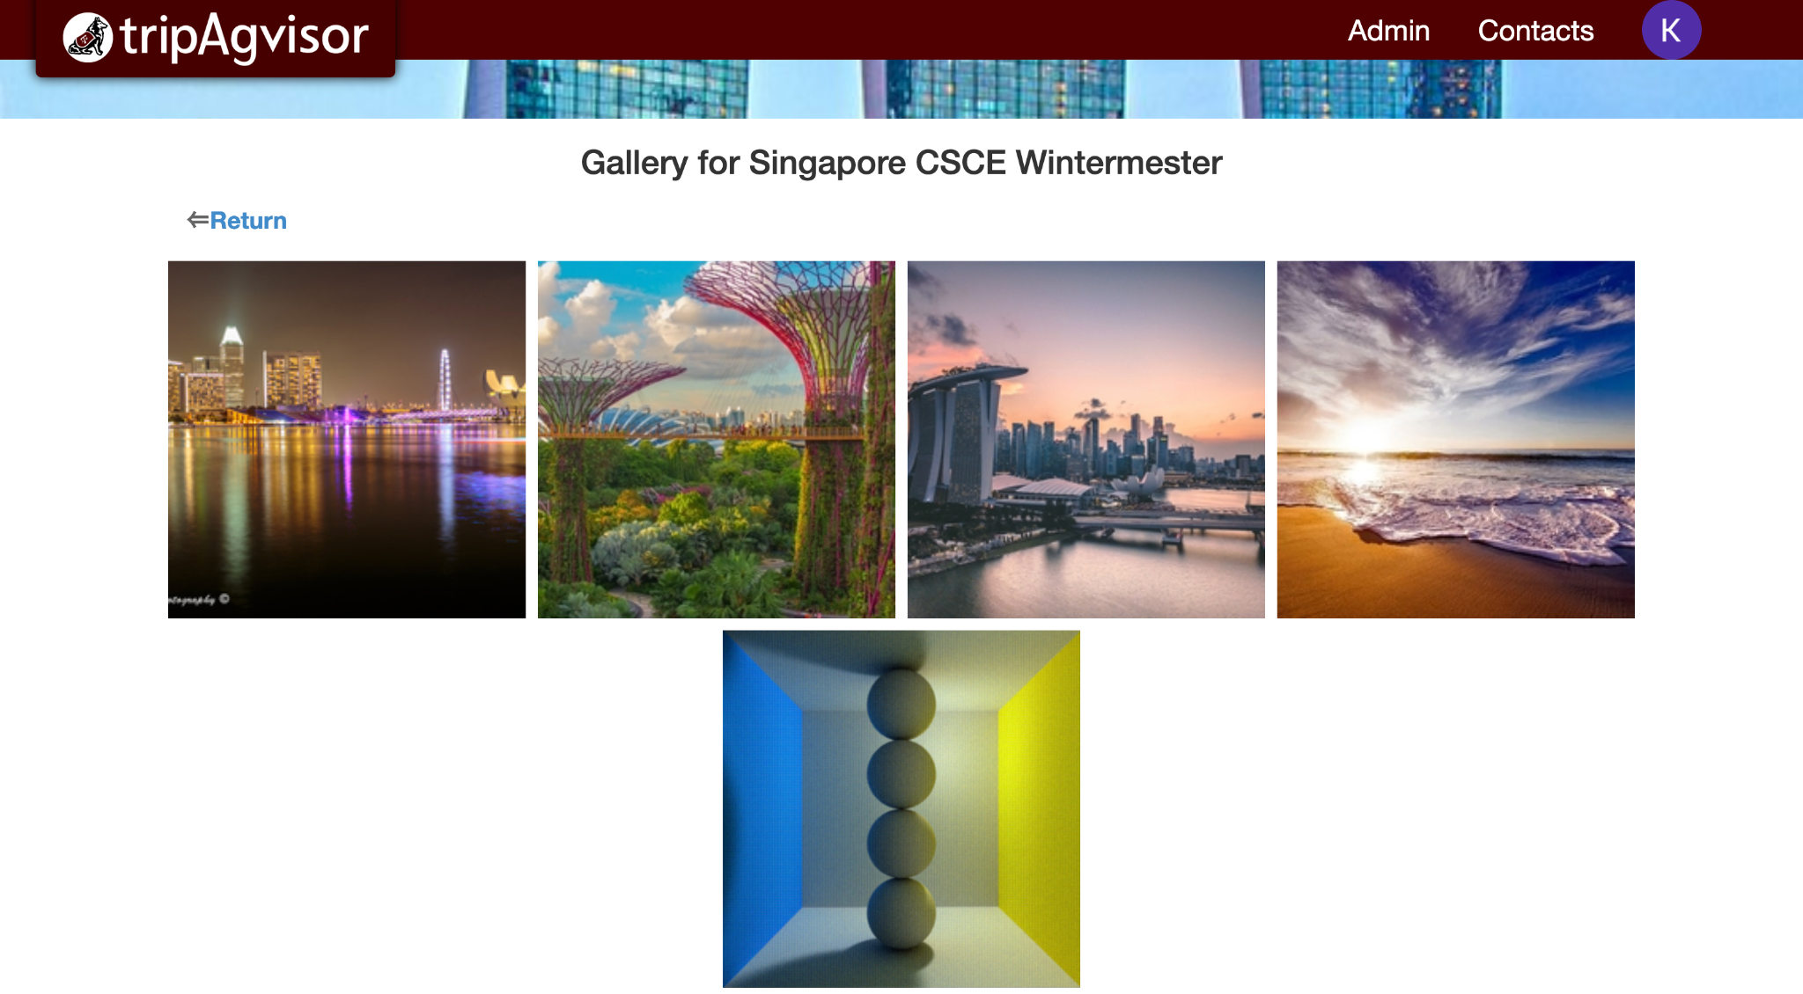

Slide 9
Challenges faced
Setting up the environment. Understanding the legacy code was a challenge and took us a few weeks to get a hang of it.
Learning to write cucumber and Rspec tests was a challenge as a lot of tests weren’t implemented in the past.
Moving over to Selenium.
Ruby on Rails.
Images.

Slide 10
Lessons Learned
TDD is hard… but worth it!
AGILE is definitely the most efficient development practice.
Organization and communication are key components of the software engineering process.
Clear documentation makes things much easier.

Slide 11
Thank you!

